Slide 1

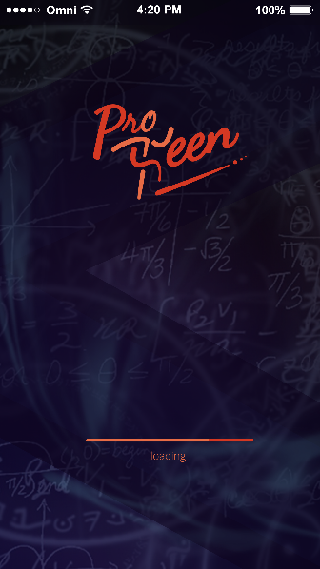

Logo - Done
Background - Done
Splash Screen - Done
Status : Finalized

Slide 2
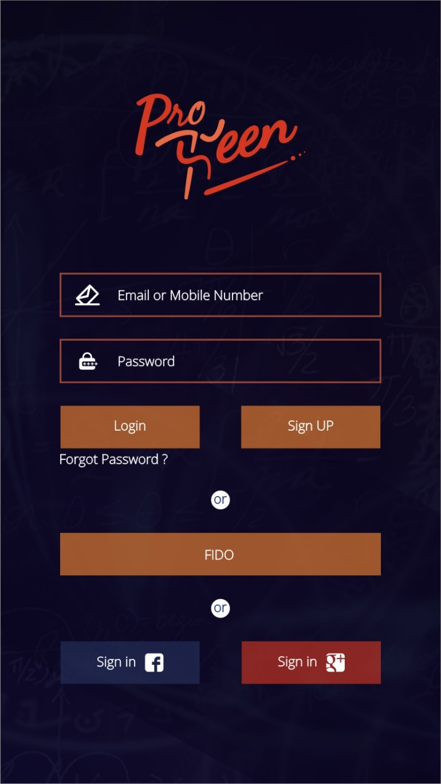
Login Screen – Option 3
Status : Finalized

Slide 3
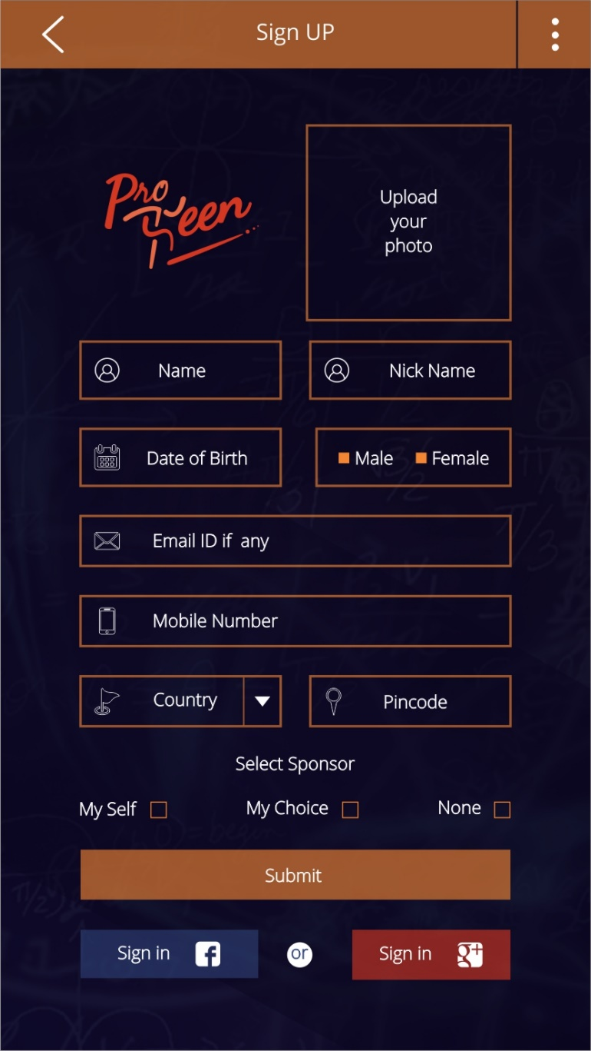
Registration Screen – Option 2
Status : Finalized

Slide 4
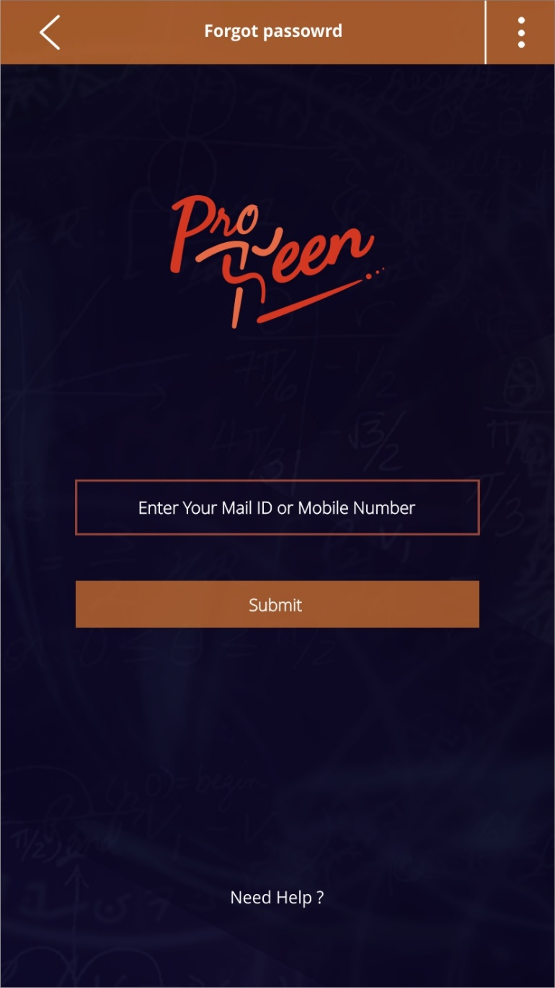
Forgot Password Screen – Option 1
Status : Finalized

Slide 5
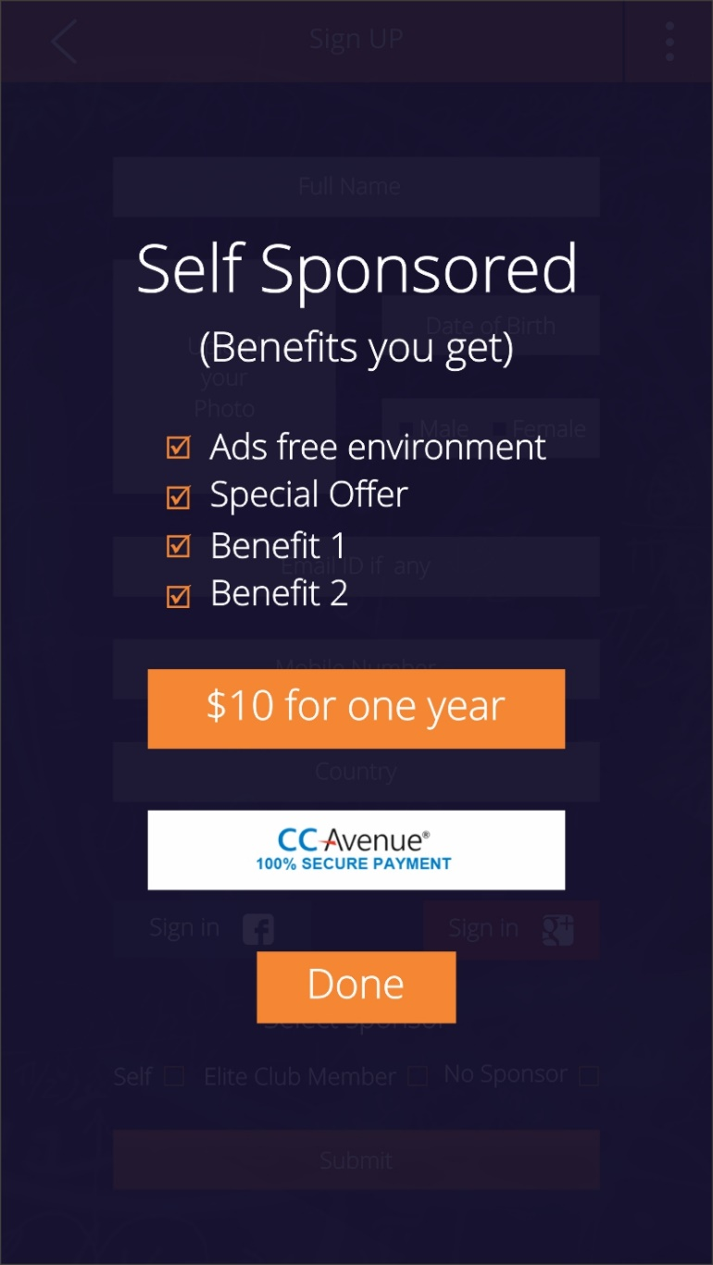
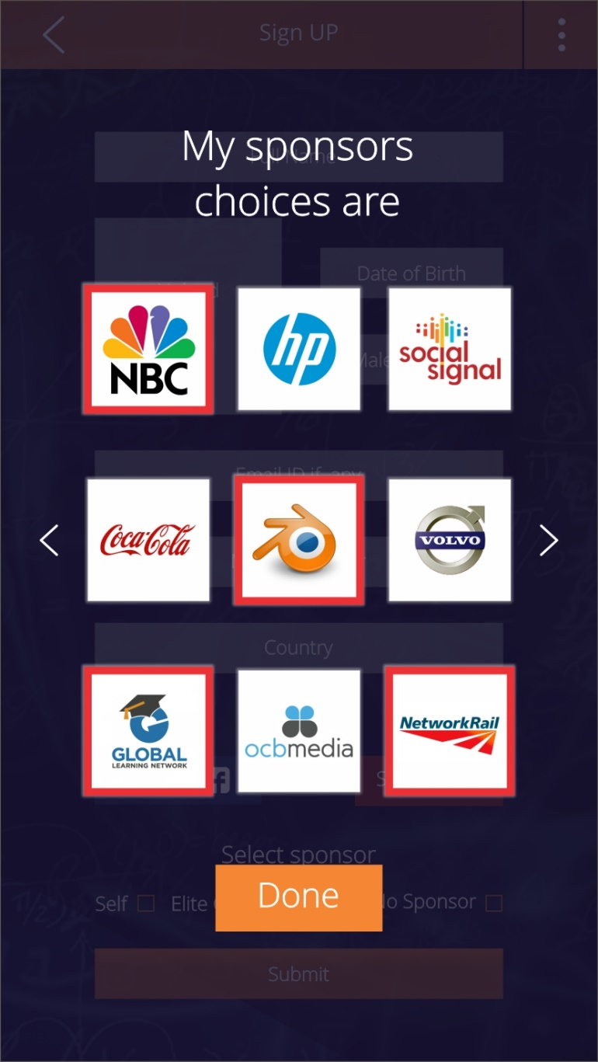
Self Sponsor Pop-Up Info Screen
My Sponsors Pop-Up Info Screen
Status : Finalized

